Slide 1


Slide 2

All controls can be bound to a DataSet to display a specific field of the current row from the DataSet. This process is called data binding.
There are two types of data binding: Simple and Complex.
  Simple Binding is binding a control to display a single value of a field in a data table. Example: TextBox
  Complex Binding: is binding a control to display more than one value of a single field or display values of more than one field. Example: Listbox, DataGridView Control

Slide 3
Simple data-bound controls do not have a DataSource property. Instead they have a group of properties under the heading DataBinding. (Example: TextBox Control)
The complex data-bound controls have a DataSource and a DataMember property. (Example Listbox)
  DataSource – Determines where the data will come from and is usually set to the name of a DataSet object. Applies to Listbox, ComboBox, DataGridView
  DisplayMember – If the DataSet contains multiple tables, we cane set the control’s DataMember property to the name of the appropriate table. Applies to Listbox, ComboBox

Slide 4

The examples for such controls are: Listbox Control & DataGridView Control
ListBox Control: This control makes use of two properties to achieve data binding:
  DataSource property to identify the table from where the information/data will be retrieved.
  DisplayMember property to identify the specific field from the data source such that this control will be able to display the values in that field. This control can be bound to a particular field’s data only either all or selected information. This all depends on the SELECT command i.e. SQL Query that was issued.

Slide 5

Declarations required:
  Dim dt As New DataTable
  dt=ds.Tables(“Student”)
Performing complex binding to a list box
  listboxname.DataSource = dt
  listboxname.DisplayMember = “ColumnName”
Associating a value:
  Listboxname.ValueMember=“ColumnName”
  To retreive the value:
  variable= Listboxname.SelectedValue

Slide 6

This control makes use of only one of its property to achieve data binding which is the DataSource property to identify the table from where the information/data will be retrieved.
Here, we are able to populate the control with any information retrieved from a table.
The Information can be all the records in the table or particular records/fields. This all depends on the SELECT command i.e. SQL Query that was issued.

Slide 7
Performing complex binding to a DataGridView control
  datagridviewname.DataSource = DataTable
Here, we require to add a DataGridView control in our form and associate it to a table by using the above line of code

Slide 8

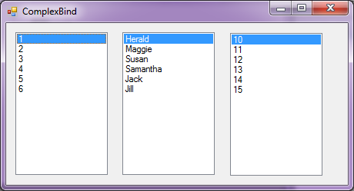

Slide 9
Public Class ComplexBind
Dim dt As New DataTable
Private Sub SimpleBind_Load(ByVal sender As System.Object,
ByVal e As System.EventArgs) Handles MyBase.Load
dt = ds.Tables("Student")
ListBox1.DataSource = dt
ListBox1.DisplayMember = "Student_Id"
ListBox2.DataSource = dt
ListBox2.DisplayMember = "Student_Name"
ListBox3.DataSource = dt
ListBox3.DisplayMember = "Roll_No"
End Sub
End Class

Slide 10

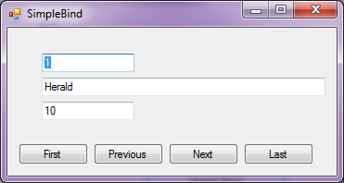

Slide 11
Public Class ComplexBind
Dim dt As New DataTable
Dim bm As BindingManagerBase
Private Sub ComplexBind_Load(ByVal sender As
System.Object, ByVal e As System.EventArgs) Handles
MyBase.Load
dt = ds.Tables("Student")
TextBox1.DataBindings.Add(“Text", dt, "Student_Id")
TextBox2.DataBindings.Add(“Text", dt, "Student_Name")
TextBox3.DataBindings.Add(“Text", dt, "Roll_No")
bm = Me.BindingContext(dt)
End Sub

Slide 12

Private Sub btnNext_Click(ByVal sender As System.Object, ByVal
e As System.EventArgs) Handles btnNext.Click
If bm.Position = bm.Count - 1 Then
MsgBox("This is the last record")
Else
bm.Position += 1
End If
End Sub

Slide 13
Private Sub btnLast_Click(ByVal sender As System.Object, ByVal e As System.EventArgs) Handles btnLast.Click
bm.Position = bm.Count – 1
End Sub
Private Sub btnFirst_Click(ByVal sender As System.Object, ByVal e As System.EventArgs) Handles btnFirst.Click
bm.Position = 0
End Sub

Slide 14
Private Sub btnPrev_Click(ByVal sender As System.Object, ByVal e As System.EventArgs) Handles btnPrev.Click
If bm.Position = 0 Then
MsgBox("This is the first record")
Else
bm.Position = bm.Position - 1
End If
End Sub
End Class

